Slide 1
Digital Image Processing Lecture – Image Watermarking and Image Morphology
Course Teacher:
Md. Rayhan Ahmed
Rayhan@cse.uiu.ac.bd

Slide 2
Image Watermarking
The methods and standards make the distribution of images (in photographs or videos) on digital media and over the Internet practical.
Unfortunately, the images so distributed can be copied repeatedly and without error, putting the rights of their owners at risk.
Even when encrypted for distribution, images are unprotected after decryption.
One way to discourage illegal duplication is to insert one or more items of information, collectively called a watermark, into potentially vulnerable images in such a way that the watermarks are inseparable from the images themselves.

Slide 3
Image watermarking
As integral parts of the watermarked images, they protect the rights of their owners in a variety of ways, including:
1. Copyright identification. Watermarks can provide information that serves as proof of ownership when the rights of the owner have been infringed.
2. User identification or fingerprinting. The identity of legal users can be encoded in watermarks and used to identify sources of illegal copies.
3. Authenticity determination. The presence of a watermark can guarantee that an image has not been altered, assuming the watermark is designed to be destroyed by any modification of the image.
4. Automated monitoring. Watermarks can be monitored by systems that track when and where images are used (e.g., programs that search the Web for images placed on Web pages). Monitoring is useful for royalty collection and/or the location of illegal users.
5. Copy protection. Watermarks can specify rules of image usage and copying (e.g., to DVD players).

Slide 4
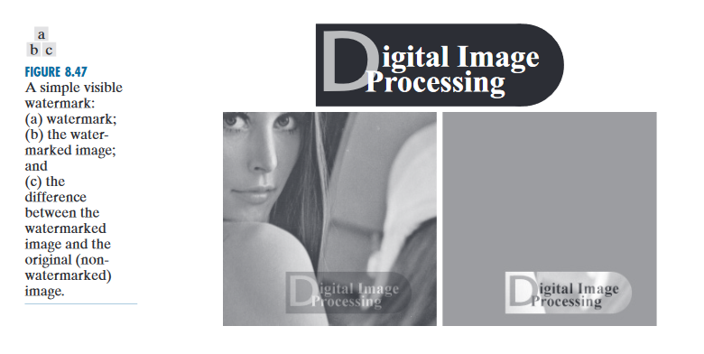
Image watermarking
A visible watermark is an opaque or semi-transparent sub-image or image that is placed on top of another image (i.e., the image being watermarked) so that it is obvious to the viewer. As the following example illustrates, visible watermarking typically is performed in the spatial domain

Slide 5
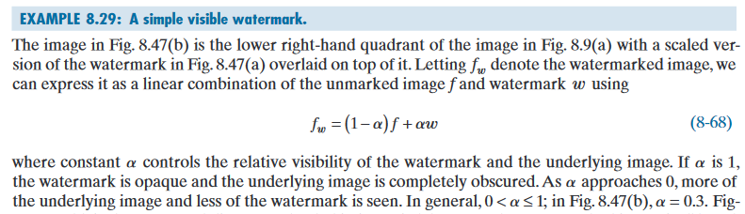
Image watermarking

Slide 6
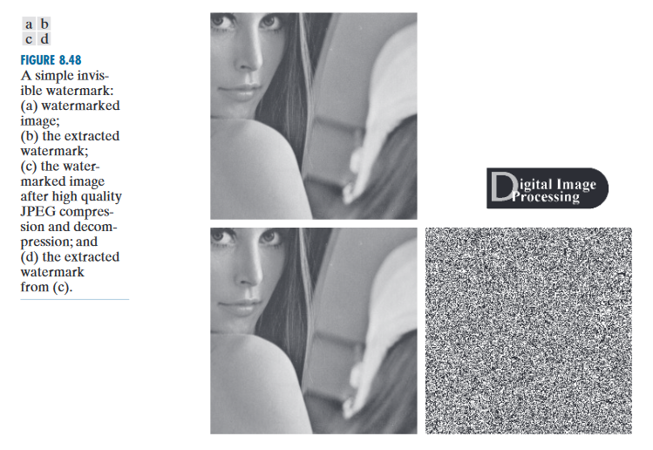
Image watermarking
Invisible watermarks are embedded in the media and use steganography technique. Invisible watermarks can not be seen with the naked eye. They are imperceptible but can be recovered with an appropriate decoding algorithm. Invisibility is assured by inserting them as visually redundant information.

Slide 7
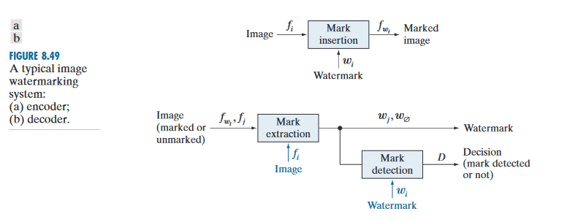
Image watermarking

Slide 8
Image Morphology
Morphological operations are defined in terms of sets. In image processing, we use morphology with two types of sets of pixels: objects and structuring elements (SE’s).
Typically, objects are defined as sets of foreground pixels. Structuring elements can be specified in terms of both foreground and background pixels.
Mainly used for segmentation and feature extraction.
There are two basic operations to image morphology:
Erosion
Dilation

Slide 9
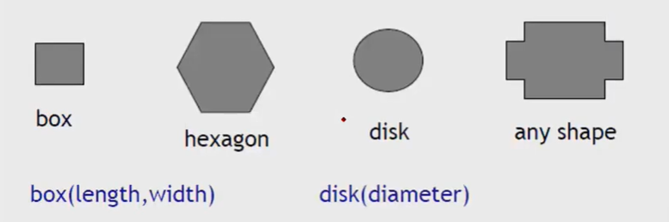
Image Morphology
Dilation: Adds pixels to the boundaries of objects in an mage
Erosion: Removes pixels on object boundaries.
Structuring element (SE): Number of pixels added or removed from the objects in an image depends on the size and shape of the structuring element used to process the image.
SE is a shape mask used in the basic morphological operations.
They can be any shape and size that is digitally representable, and each has an origin.

Slide 10

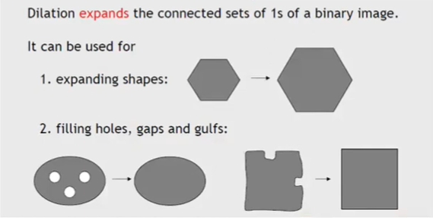
Dilation
Fills in holes.
Smoothens objects boundaries.
Adds an extra outer ring of pixels onto object boundary .
Thus the object becomes slightly larger.

Slide 11
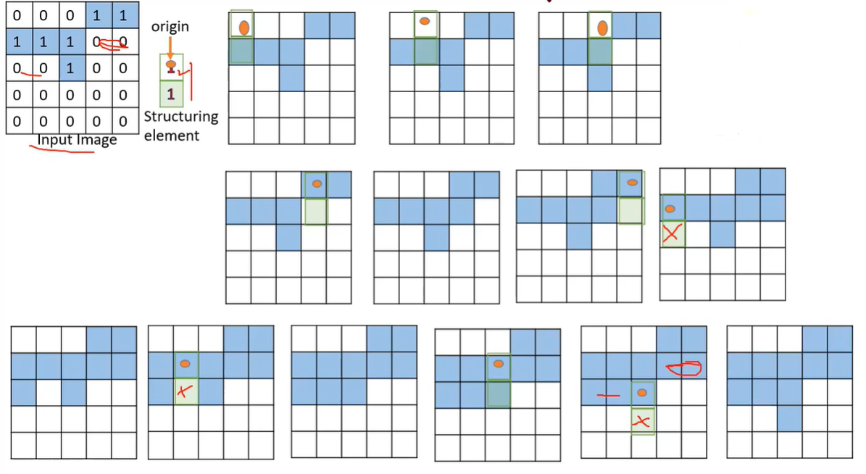
Dilation

Slide 12
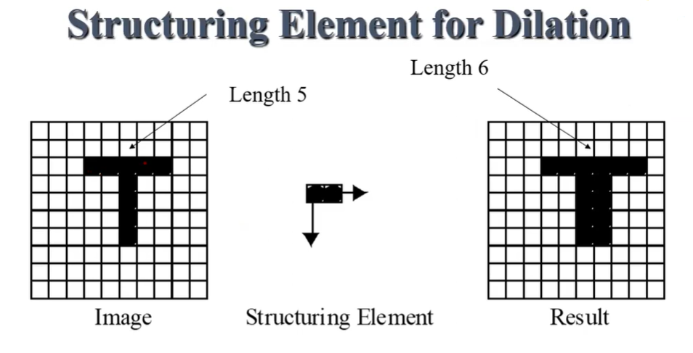
Dilation

Slide 13
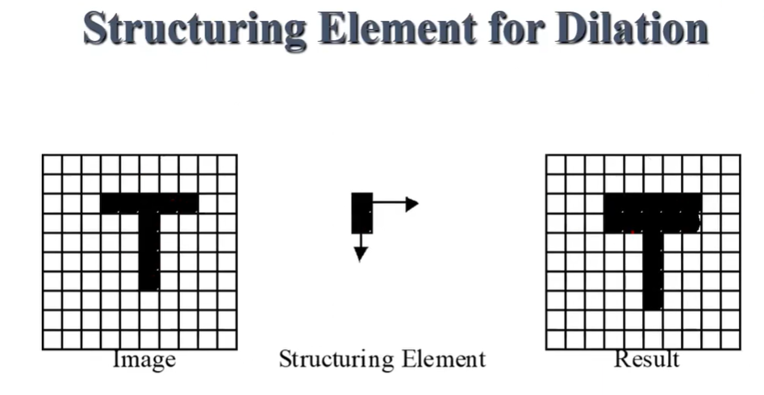
Dilation

Slide 14
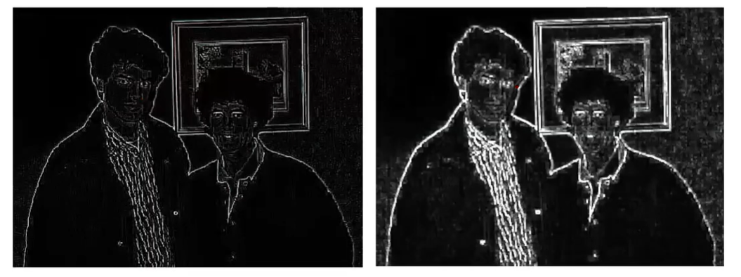
Dilation

Slide 15
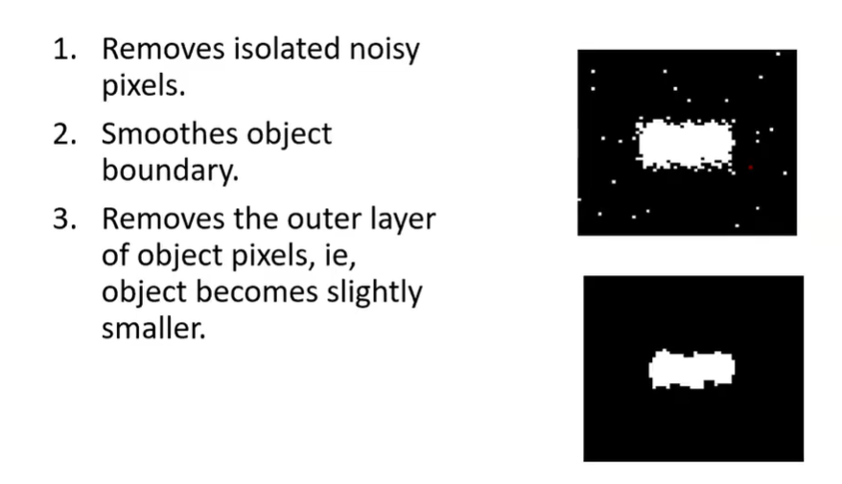
Erosion

Slide 16
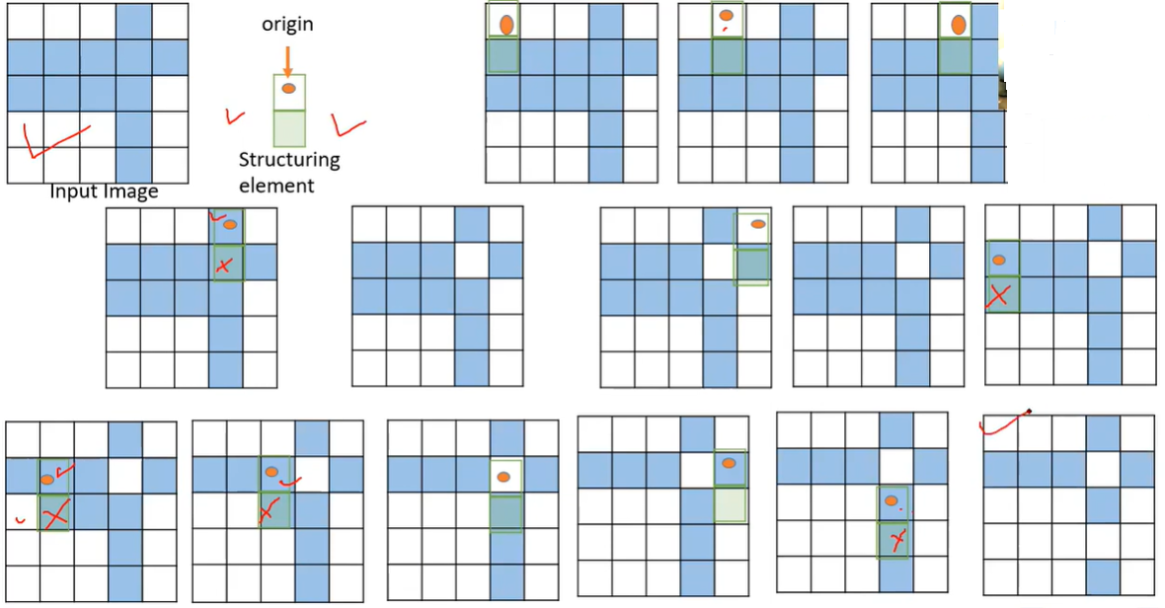
Erosion

Slide 17
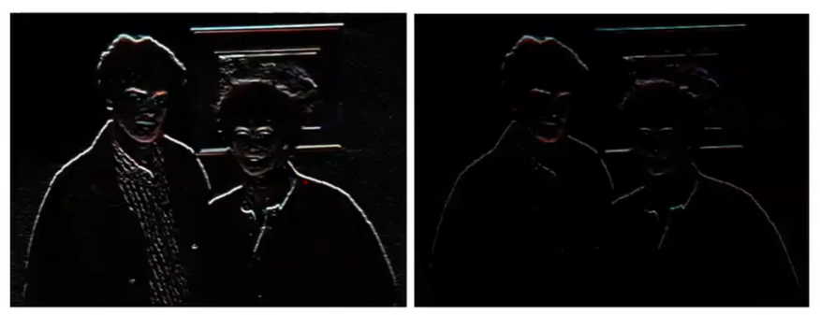
Erosion

Slide 18
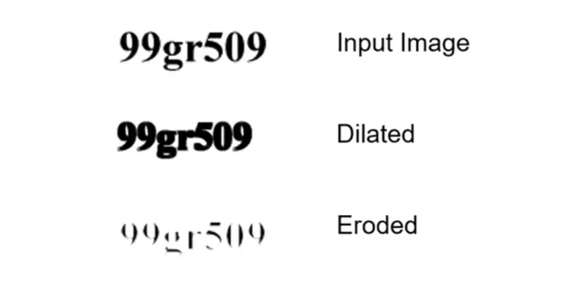
Examples

Slide 19
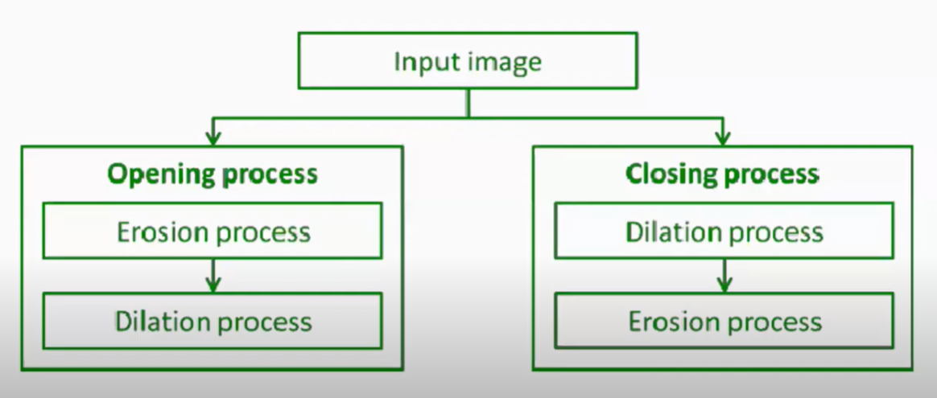
Opening and Closing operations

Slide 20
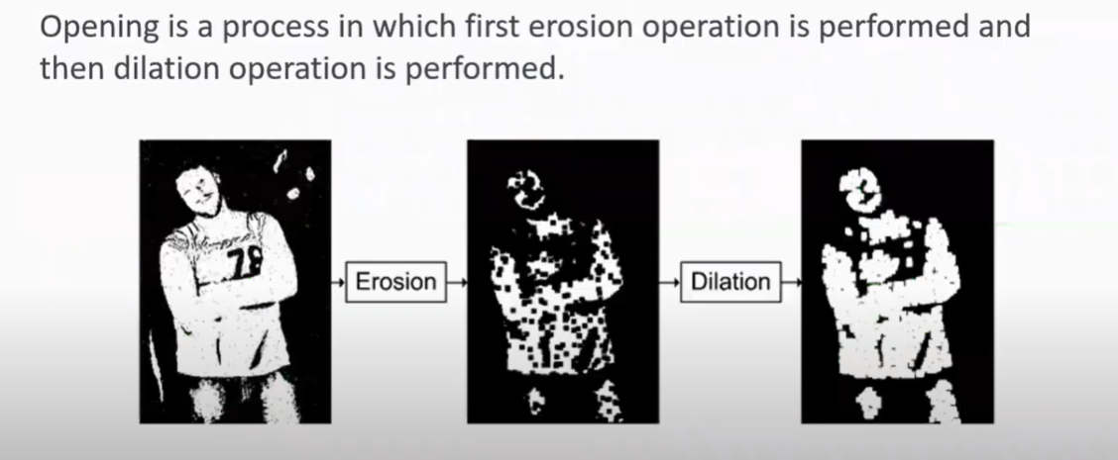
Opening operation

Slide 21
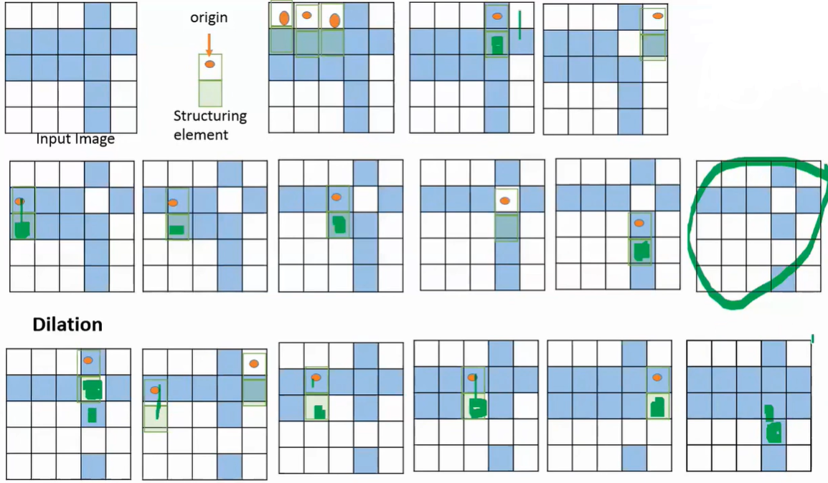
Opening Operation

Slide 22
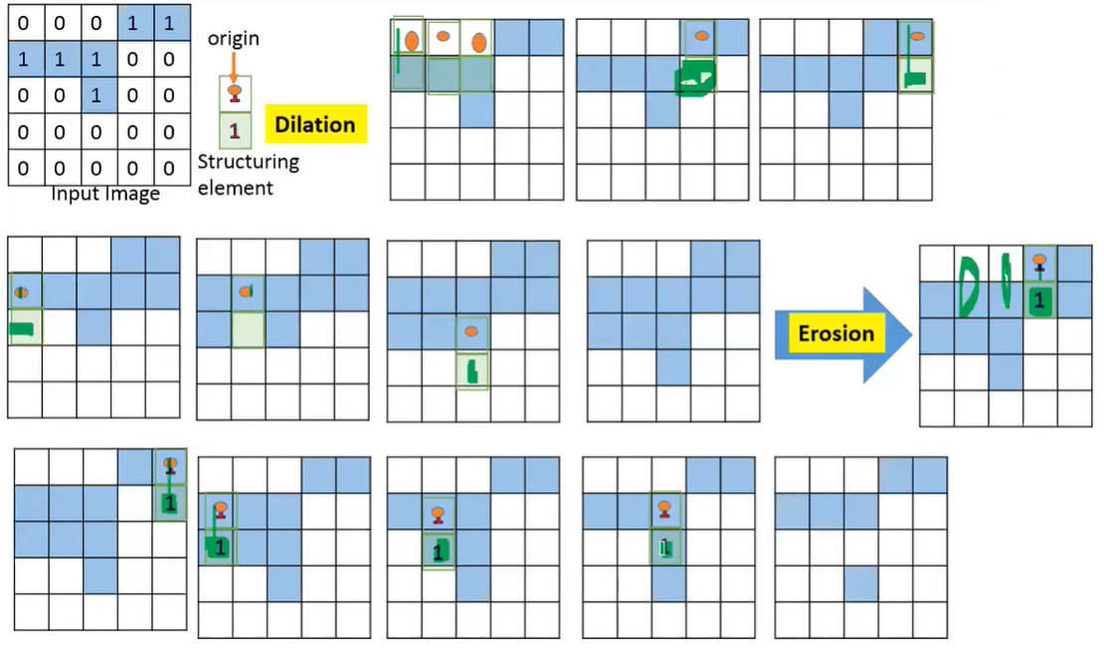
Closing Operation

